Slide 1
LASSO REGRESSION
TuringMinds.Ai
REGULARIZATION TECHNIQUE
INTERNSHIP IMMEDIATE LEAD
P. SRI HARI PRIYA
27-03-2023
REDDAPPA M R

Slide 2
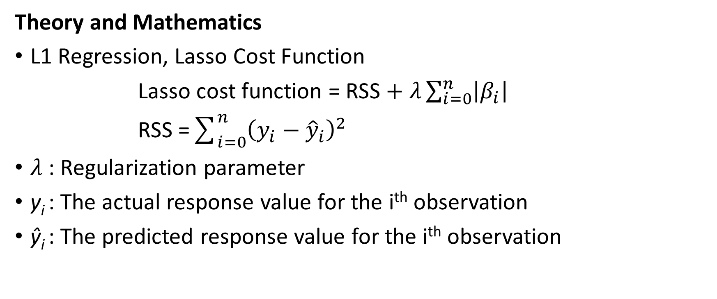
Theory and Mathematics
L1 Regression, Lasso Cost Function
Lasso cost function = RSS $+ λ\sum_{i=0}^{n}{\left|β_{i}\right|}$
RSS =$\sum_{i=0}^{n}{{\left(y_{i}−{\hat{y}}_{i}\right)}^{2}}$
$λ$: Regularization parameter
y_{i} : The actual response value for the i^{th} observation
ŷ_{i} : The predicted response value for the i^{th} observation

Slide 3
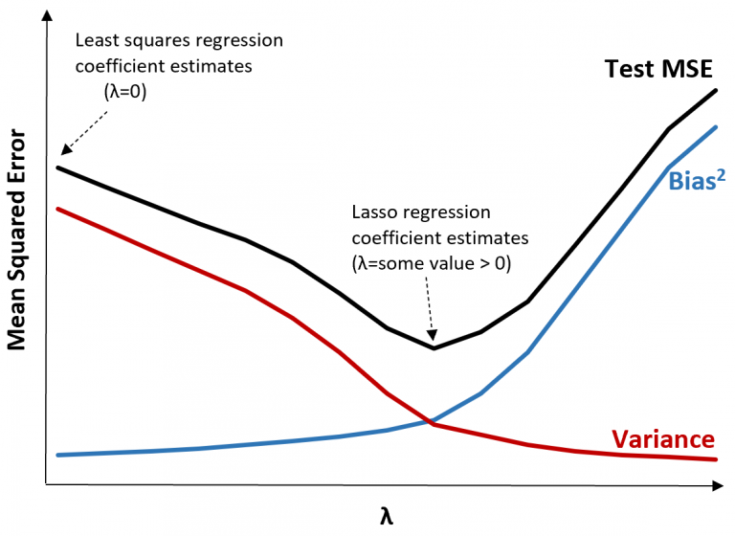

Slide 4
Applications
Feature Selection
Predictive Modelling
High dimensional data analysis
Model Simplification
Handling Multicollinearity
Advantages and Limitations
Pros and Corns of Lasso Regression

Slide 5
Conclusion
Eliminates the least important features.

Slide 6
LASSO REGRESSION
Flow chart
Import libraries
Processed data
EDA
Visualisation
Read the dataset
Train test split
Hyper parameter tuning
Cross validation
Pre-processing
Model building
Evaluation
Test with new data
MSE

Slide 7
LASSO REGRESSION
Importing libraries
Pre-processing
Scaling
Model Building
Model evaluation

Slide 8
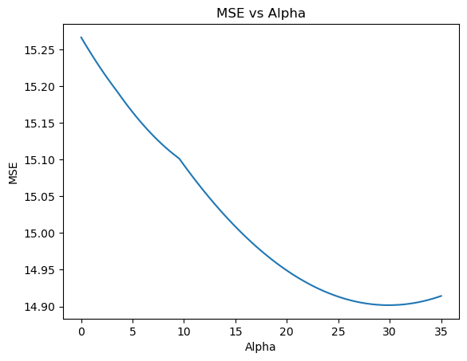

Slide 9
LASSO REGRESSION
Importing the libraries
Splitting train & test
Model building
Hyper parameter
tuning
Reading the data
Scaling the data
Fitting the data
Grid search cv
Checking the data
Building algorithm
Predicting for new data
Random search cv
Assigning X and y
Calling the algorithm
Checking performers metrics

Slide 10
LASSO REGRESSION
WITH SKLEARN |  | WITH OUT SKLEARN
Lasso | Grid-Search-CV | Lasso | Grid-Search-CV
R2_score = 67.22 | R2_score = 73.89 | R2_score = 77.88 | R2_score = 78.09
Adjusted R2 = 59.18 | Adjusted R2 = 67.48 | Adjusted R2 = 77.50 | Adjusted R2 = 77.75
MAE = 3.82 | MAE = 3.61 | MAE = 2.80 | MAE = 2.81
MSE = 29.49 | MSE = 24.49 | MSE = 15.24 | MSE = 15.09
RMSE = 5.43 | RMSE = 4.84 | RMSE = 3.90 | RMSE = 3.88

Slide 11
FLOW CHART
Acquire data
Identifying missing values
Visualization
Feature scaling
Import libraries
Handling missing values
Encoding categorical variables
Model building
Import data
Merging datasets
Splitting the data
Fitting and predicting using the model

Slide 12
LASSO REGRESSION
Datasets | R2_score | Mean absolute error | MSE | RMSE
Car price | 0.8464 | 409502.61 | - | 641860.23
Sale of retail store | 0.1978 | 1.77 | 5.67 | 2.38
Flight price | 0.9102 | 4512.96 | - | 6810.68
Melbourne house | 0.5323 | 220752.72 | - | 288884.75
Air quality | 0.8348 | 30.00 | 3374.06 | 58.09

Slide 13
LASSO REGRESSION DEPLOYMENT
STREAMLIT
Taking model
Create the app.py
View app in the browser
Load the model
Deploy it

Slide 14
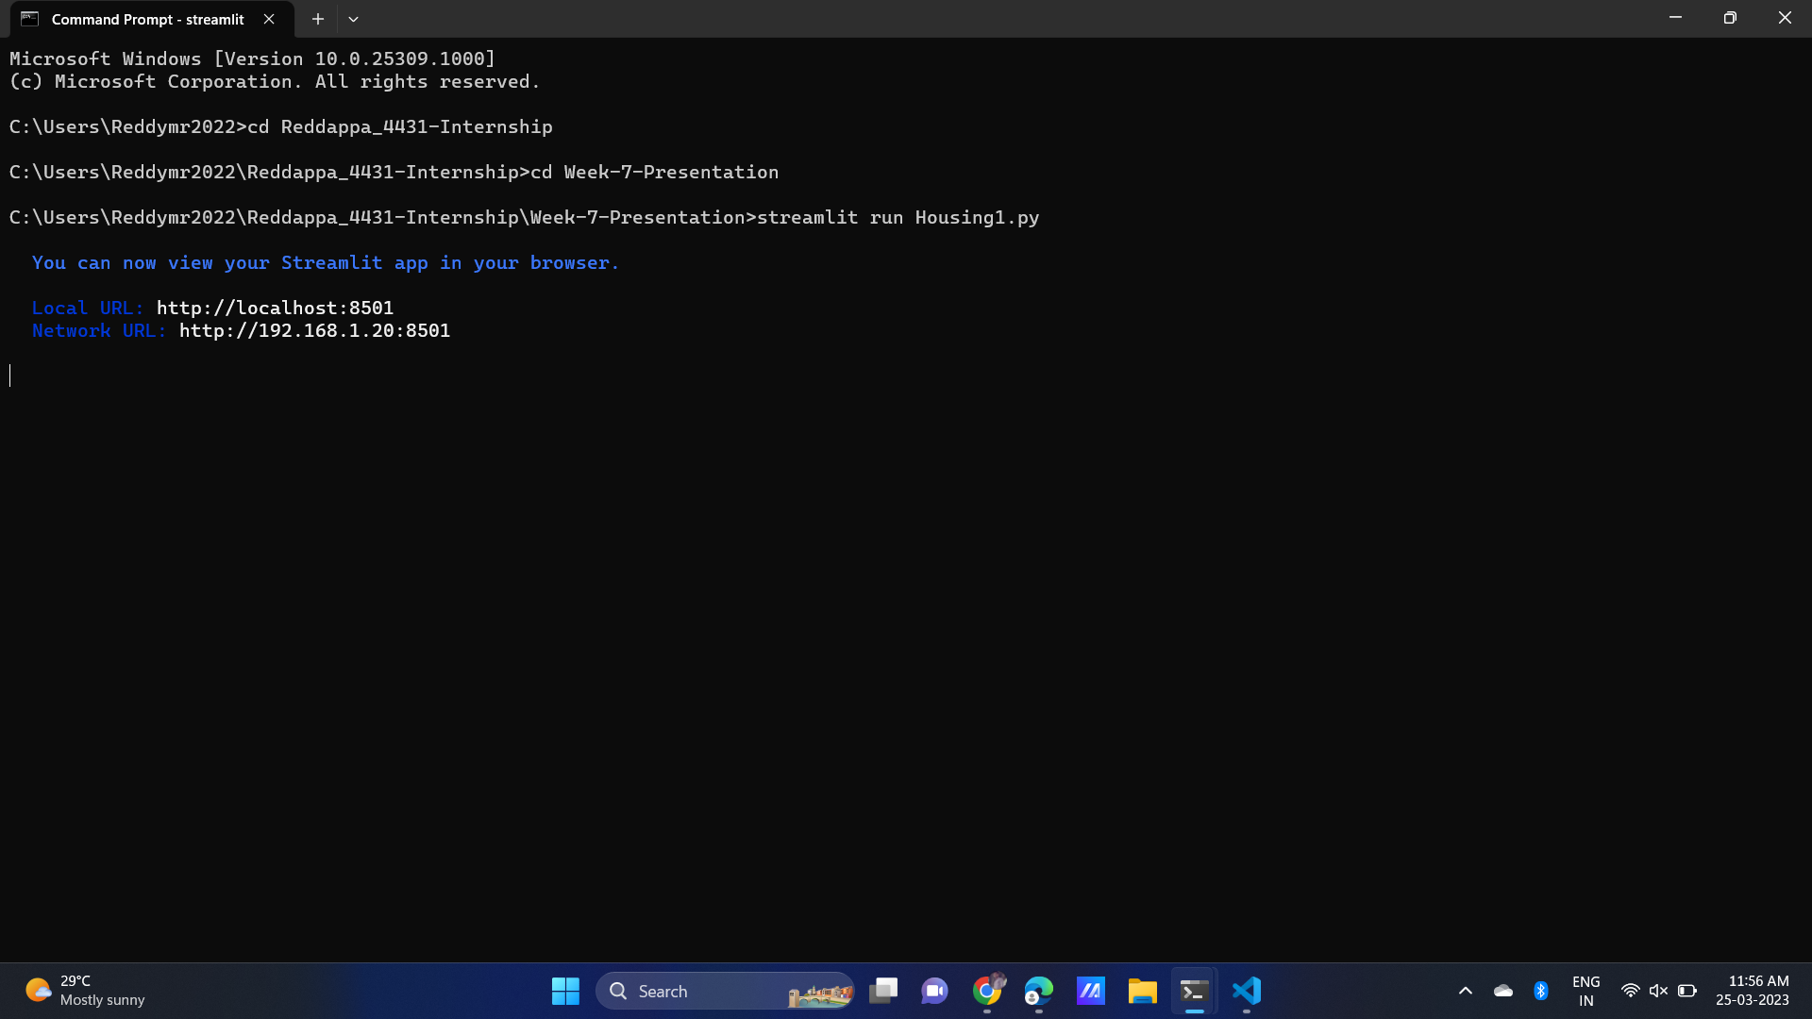

Slide 15
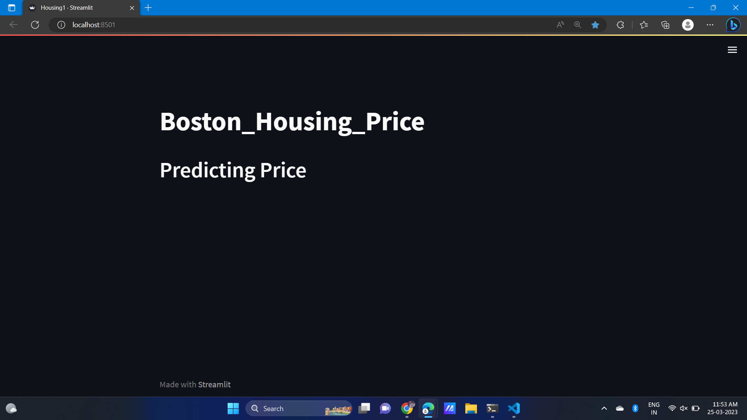

Slide 16
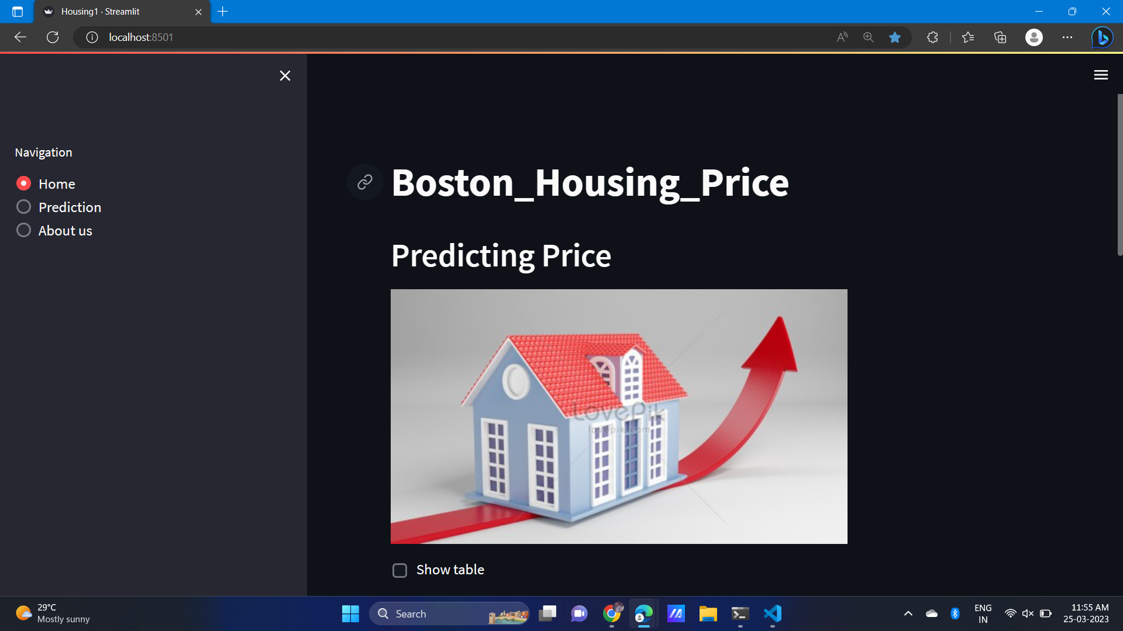

Slide 17
Thank you

